Slide 1
MEMORIES
DUM, DUM, DUM, DUM, DUM x4
CHORUS
Here's to the ones that we got Cheers to the wish you were here, but you're not 'Cause the dreams bring back all the memories Of everything we've been through Close to the ones here today Close to the ones that we lost on the way 'Cause the dreams bring back all the memories And the memories bring back, memories bring back you.
There's a time that I remember, when I did not know no pain When I believed in forever, and everything would stay the same Now my heart feel like December when somebody say your name 'Cause I can't reach out to call you, but I know I will one day, yeah
Everybody hurts sometimes Everybody hurts someday, yeah But everything will be alright Go and raise your voice and say, ayy
CHORUS
Doo doo, doo doo doo doo Doo doo doo doo, doo doo doo doo Doo doo doo doo, doo doo doo Memories bring back, memories bring back you
There's a time that I remember when I never felt so lost When I felt all of the hatred was too powerful to stop
Now my heart feel like an ember and it's lighting up the dark I'll carry these torches for ya that you know I'll never drop, yeah
Everybody hurts sometimes Everybody hurts someday, ayy ayy
But everything will be alright Go and raise your voice and say, ayy
CHORUS
Doo doo, doo doo doo doo Doo doo doo doo, doo doo doo doo Doo doo doo doo, doo doo doo Memories bring back, memories bring back you Doo doo, doo doo doo doo Doo doo doo doo, doo doo doo doo Doo doo doo doo, doo doo doo Memories bring back, memories bring back you
Yeah, yeah, yeah Yeah, yeah, yeah, yeah, yeah, doh, doh Memories bring back, memories bring back you. CHOIR

Slide 2
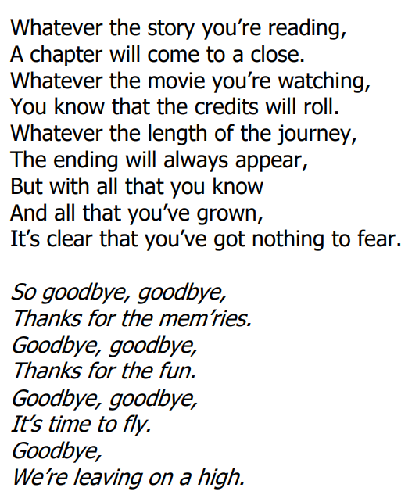

Slide 3
NEVER GONNA GIVE YOU UP
We're no strangers to love You know the rules and so do I (do I) A full commitment's what I'm thinking of You wouldn't get this from any other guy
I just wanna tell you how I'm feeling Gotta make you understand
Never gonna give you up Never gonna let you down Never gonna run around and desert you Never gonna make you cry Never gonna say goodbye Never gonna tell a lie and hurt you
We've known each other for so long Your heart's been aching, but you're too shy to say it (say it) Inside, we both know what's been going on (going on) We know the game and we're gonna play it
And if you ask me how I'm feeling Don't tell me you're too blind to see
CHORUS x 2
Ooooh, give you up
Never gonna give, never gonna give
We've known each other for so long Your heart's been aching, but you're too shy to say it (to say it) Inside, we both know what's been going on (going on) We know the game and we're gonna play it
I just wanna tell you how I'm feeling Gotta make you understand
CHORUS x 3
Sing along - https://www.youtube.com/watch?v=dQw4w9WgXcQ
Backing track - https://www.youtube.com/watch?app=desktop&v=5bCwue1d9Js

